Slide 1
Deep Learning with Tensorflow
Seth Juarez
@sethjuarez

Slide 2
Agenda
Machine Learning is Different
Data is the Key
Tensors and Datasets
Crafting a Model
Model
Making the Model Better
Loss/Cost, Optimization
Using a Model
Save/Load/Use

Slide 3
Machine Learning…

Slide 4

programming
algorithm
answers
input

Slide 5
machine learning
answers
algorithm
input

Slide 6

machine learning
Tensorflow
model
data

Slide 7
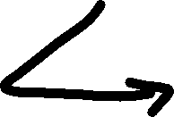
machine learning
data
Tensorflow
model / algorithm
code
answers
input

Slide 8
Data is Key
Computer Vision – three easy examples

Slide 9
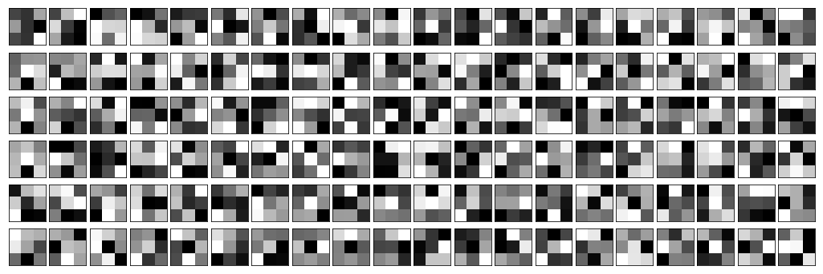
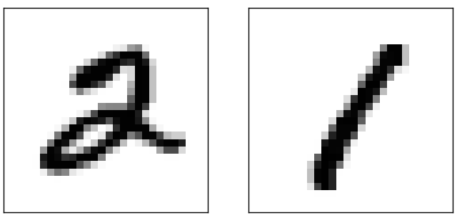
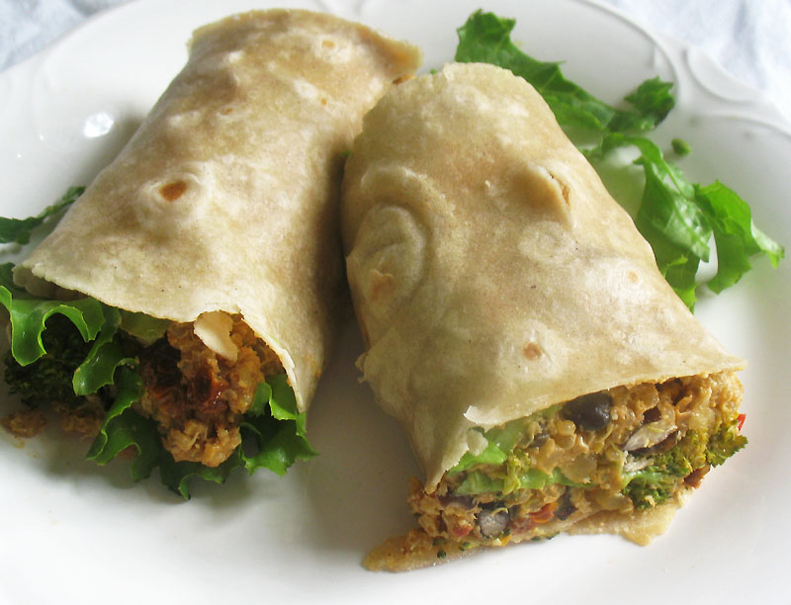
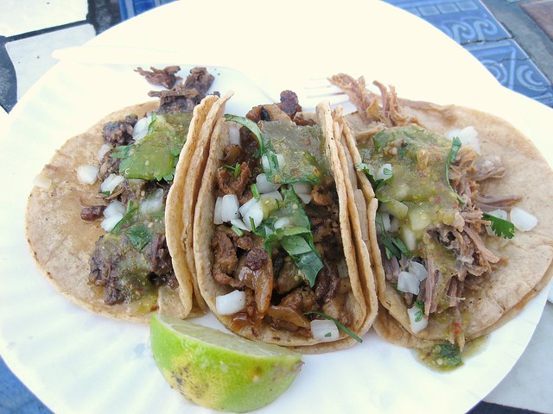

Slide 10
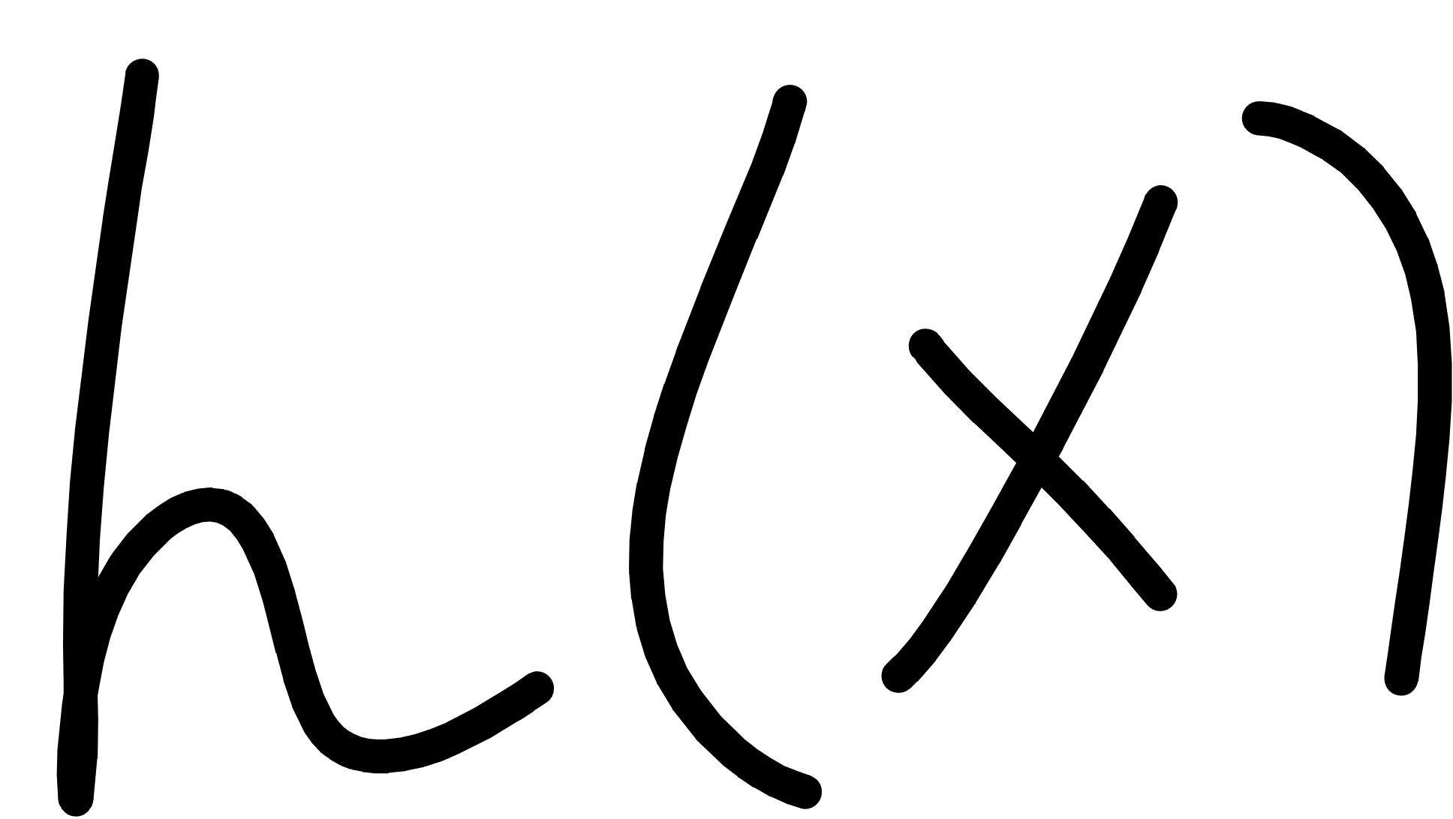
Notes:
Cover the fact that ML uses data to make its own functions

Slide 11
Notes:
Cover the fact that ML uses data to make its own functions

Slide 12
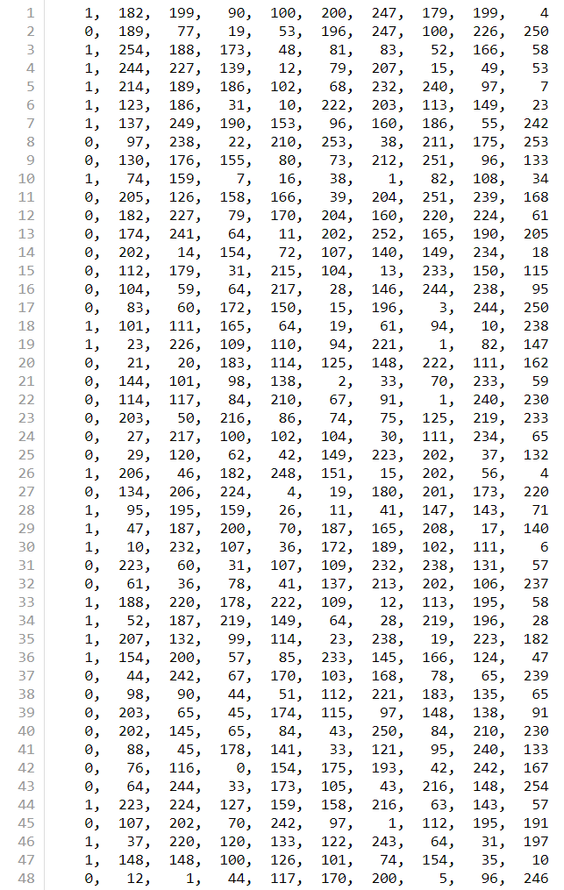


Slide 13
Tensorflow Tensors
tf.Tensor – promise of future values
tf.Variable – tensor that can be updated
tf.constant – constant…
tf.placeholder – promise of future provided value

Slide 14
Tensors and Datasets
data.ipynb

Slide 15
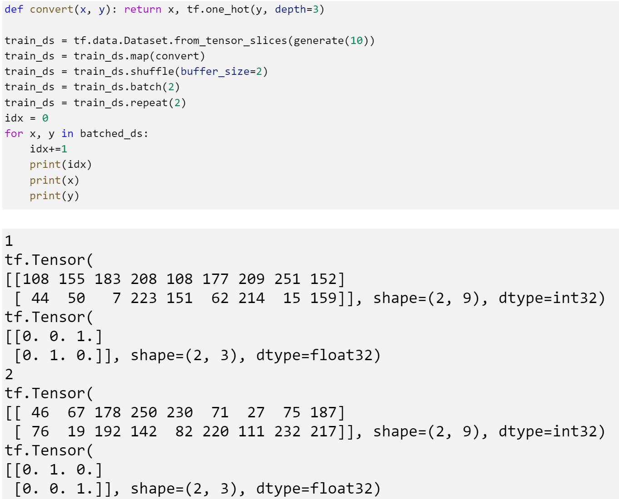

Slide 16
Creating a Model
“Machine Learning is a lazy way of writing a Function” - Dr. Inttr Nette

Slide 17
Notes:
Cover the fact that ML uses data to make its own functions

Slide 18
Notes:
Cover the fact that ML uses data to make its own functions

Slide 20
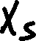
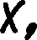
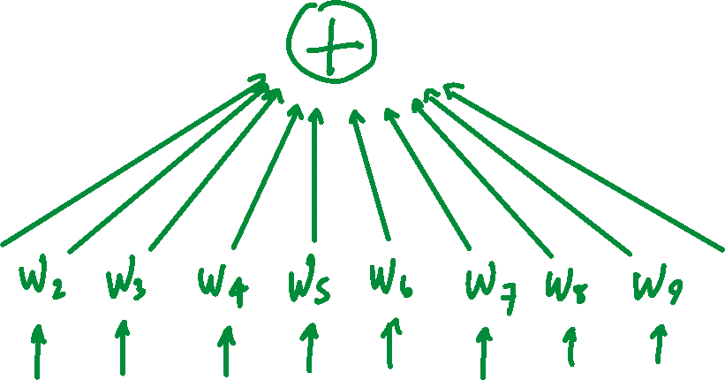
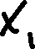

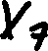

Slide 21
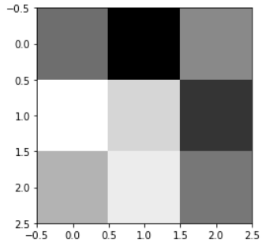
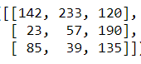
[142, 233, 120, 23, 57, 190, 85, 39, 135]

Slide 22
[ 1, 1, 1, 0, 0, 0, -1, -1, -1]
[142, 233, 120, 23, 57, 190, 85, 39, 135]
236

Slide 23
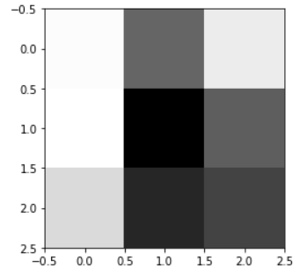
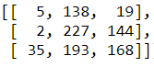
[5, 138, 19, 2, 227, 144, 35, 193, 168]

Slide 24
[ 1, 1, 1, 0, 0, 0, -1, -1, -1]
[5, 138, 19, 2, 227, 144, 35, 193, 168]
-234

Slide 25
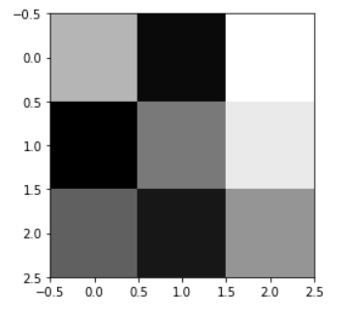
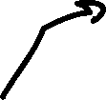
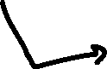
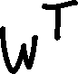


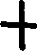
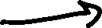

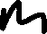
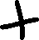

Slide 26
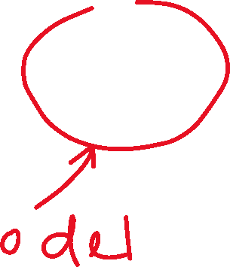





Slide 27



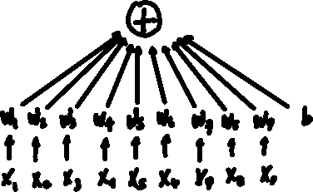

top
middle
bottom

Slide 28
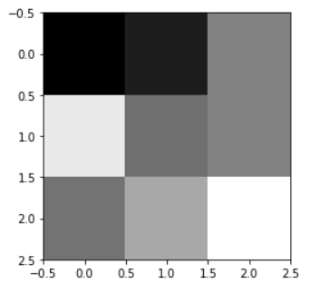
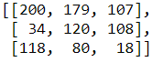
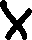



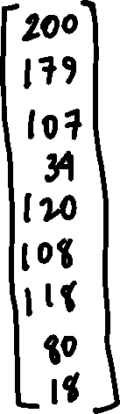
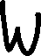

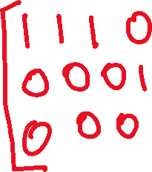
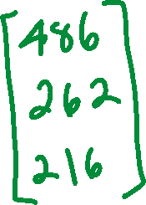

Slide 29

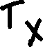




Slide 30
Constructing Models in Tensorflow
squares.ipynb

Slide 31
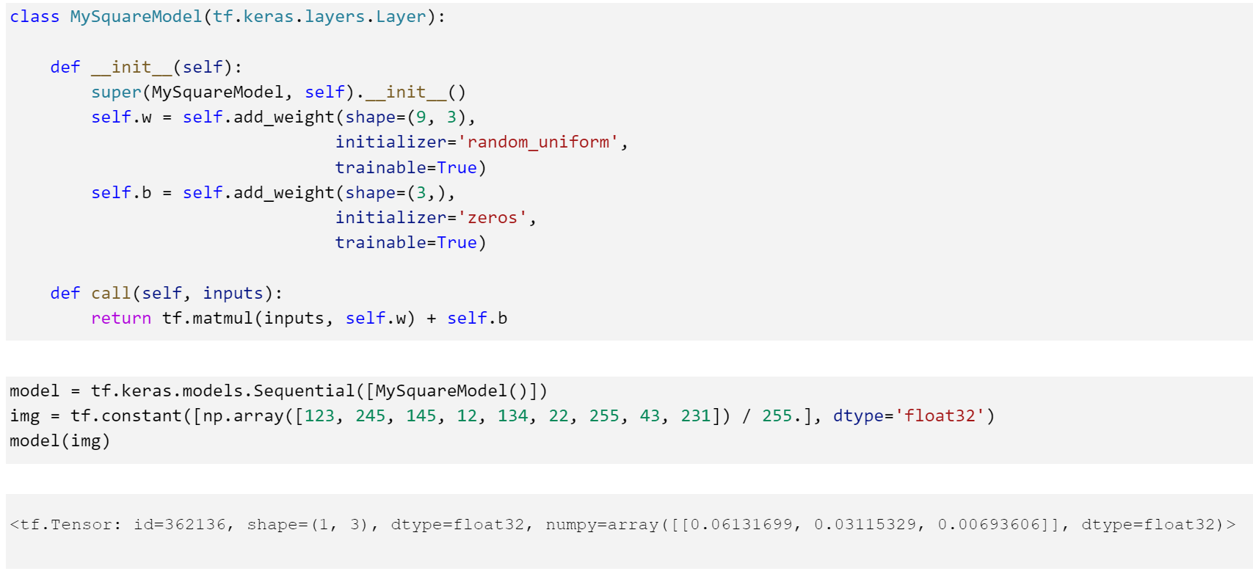

Slide 32
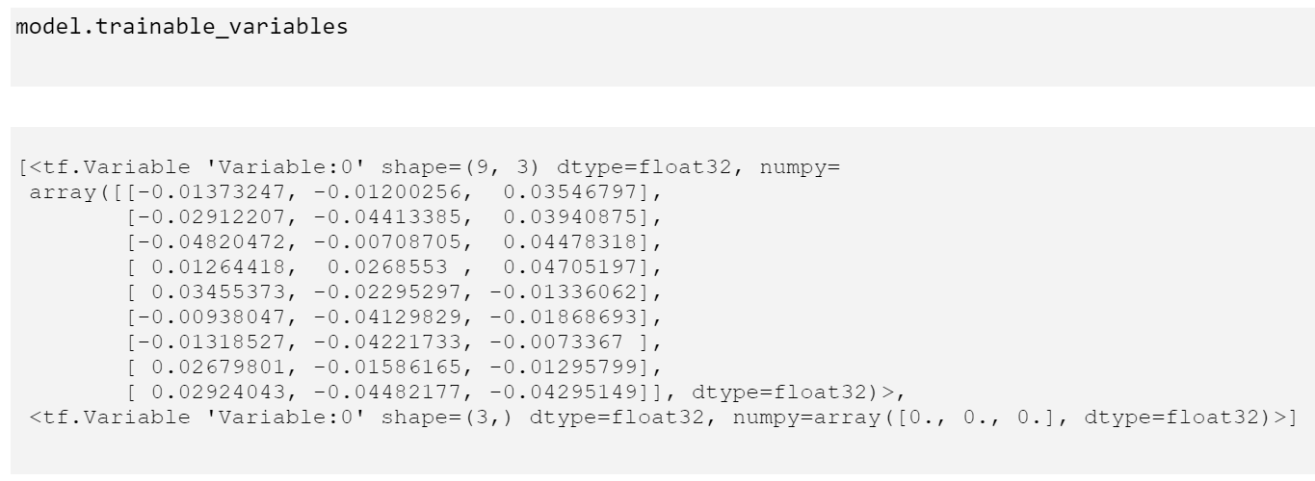

Slide 33
Making the Model Better
“Sometimes Math is ok if we use it right…”
- Dr. Inttr Nette

Slide 34












Slide 35










Slide 37
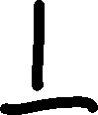






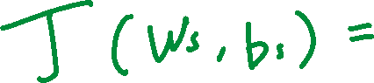
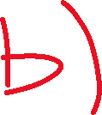
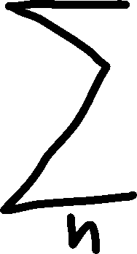



Slide 38
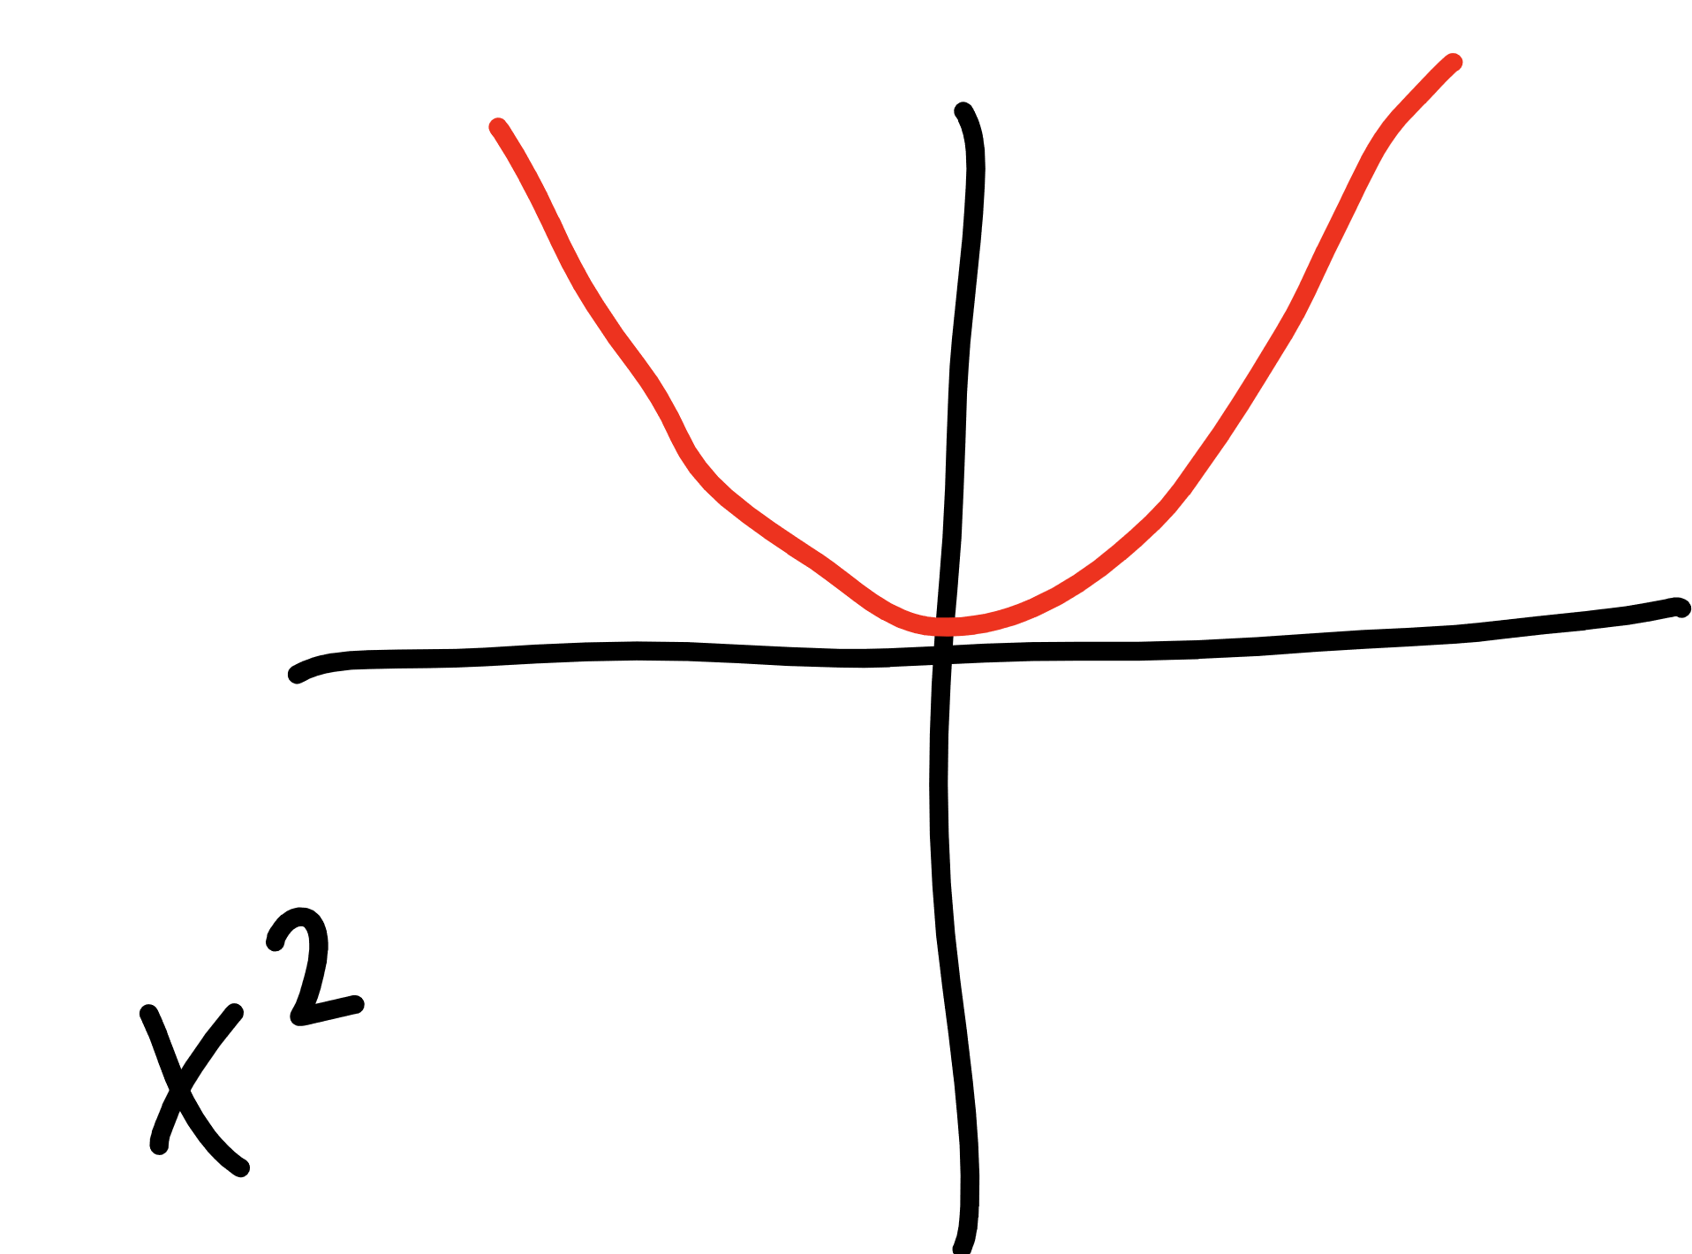
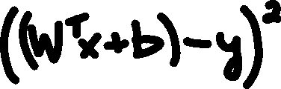

Slide 39



Slide 40

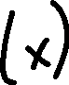
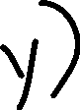
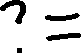
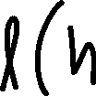
Making the Model Better
model – the function shape we construct
cost/loss function – a function that tells us how bad we are at predicting
optimizer – method for reducing how bad we are at predicting

Slide 41
Keeping track of things…
roll the tape…

Slide 42
with tf.GradientTape() as tape:
pred = model(X)
loss = cost(pred, Y)
grads = tape.gradient(loss, model.trainable_variables)
optimizer.apply_gradients(zip(grads, model.trainable_variables))

Slide 43
Putting it all together
THE LOOP!

Slide 44
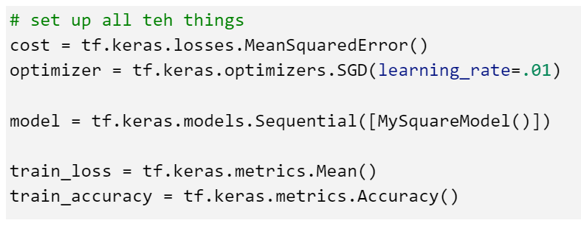
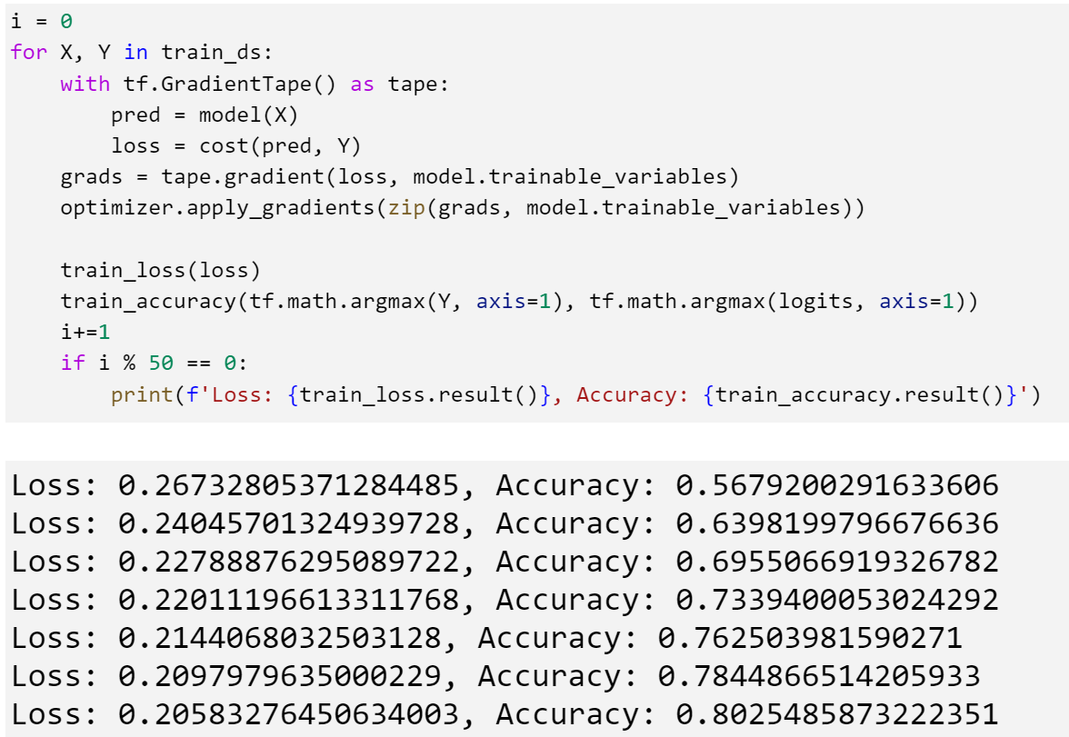

Slide 45
Using the Model
squares.ipynb

Slide 46
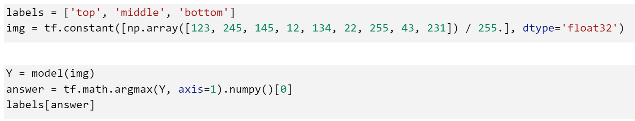

Slide 47
Review
Machine Learning is Different
Data is the Key
Tensors, Datasets, and DataLoaders
Crafting a Model
Model
Making the Model Better
Loss/Cost, Optimization
Using a Model
Save/Load/Use

Slide 48


Slide 49


Slide 50
Digits tho…

Slide 52






Slide 53


Slide 54


Slide 56





Slide 57


Slide 58


Slide 59


Notes:
Proof by induction

Slide 60

Notes:
Derivative?
Architecture

Slide 61


Slide 62
Better Network…

Slide 63
filters and pooling

Slide 64
filters
2 | 4 | 9 | 1
6 | 3 | 5 | 7
2 | 8 | 2 | 4
9 | 7 | 3 | 6
1 | 1 | 1
0 | 0 | 0
-1 | -1 | -1
3 | 0
-5 | -1

Slide 65
padding
0 | 0 | 0 | 0 | 0 | 0
0 | 2 | 4 | 9 | 1 | 0
0 | 6 | 3 | 5 | 7 | 0
0 | 2 | 8 | 2 | 4 | 0
0 | 9 | 7 | 3 | 6 | 0
0 | 0 | 0 | 0 | 0 | 0
-9 | -14 | -15 | -12
-4 | 3 | 0 | 7
-7 | -5 | -1 | 3
10 | 12 | 14 | 6
1 | 1 | 1
0 | 0 | 0
-1 | -1 | -1

Slide 66
pooling
-9 | -14 | -15 | -12
-4 | 3 | 0 | 7
-7 | -5 | -1 | 3
10 | 12 | 14 | 6
3 | 7
12 | 14

Slide 67
Notes:
Derivative?
Architecture

Slide 68



Slide 69
Putting it all together
a full run through to production

Slide 70
Review
Machine Learning is Different
Data is the Key
Tensors, Datasets, and DataLoaders
Crafting a Model
Model
Making the Model Better
Loss/Cost, Optimization
Using a Model
Save/Load/Use

Slide 71

Seth Juarez
Microsoft
@sethjuarez

